Slide 1




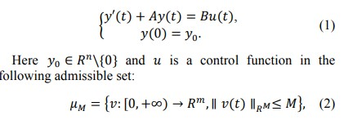
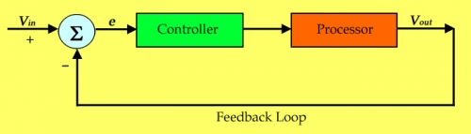


Applications of matrices in control theory
K. J. Somaiya College of Engineering, Mumbai – 400 077
(A Constituent College of Somaiya Vidyavihar University) Dept. of Science and Humanities
F.Y. B. Tech. Semester –I (2022-23)
Applied Mathematics-I
IA-I
Control theory is a branch of Applied Mathematics dealing with the use of feedback to influence the behavior of a system in order to achieve a desired goal. One can distinguish two classes of systems for which control theory plays an indispensable role, namely man-made systems and biological systems.
A simple example of a man-made system is cruise control for a car. The actual speed is recorded by the speedometer and is "fed-back" and compared to the speed setting on the cruise control, which causes the engine to accelerate if the speed is too low. The cruise control device is referred to as the controller in the system.
NAME : KASHISH MAMANIA
ROLL NO. : 16010122104
DIV: C2 BATCH: 1
Control theory has long been influenced by engineering and technology, which has been its traditional area of impact. For instance, the creation of a control device known as a steam engine regulator in the 18th century significantly influenced industrial growth in Europe. However, the mathematical theory of control was not developed until much later, mostly over the last 60 years.
Let A and B be two matrix in R^{nxn} and R^{nxm} respesctively, where n, m ∈ N. Consider the following controlled ordinary differential equation:
Here, M is a positive constant.
V_{in} is the desired speed, set by the driver. V_{out} is the actual speed on the speedometer. The pale blue device calculates the error: e = V_{in} - V_{out} The processor represents the engine and braking system.
Action of the controller:
if e > 0, then accelerate
if e < 0, then decelerate
If you study control theory you will encounter so-called block diagrams, which are schematic representations of control systems and help one to understand how they work. Below is the block diagram for a cruise control system.

Slide 2
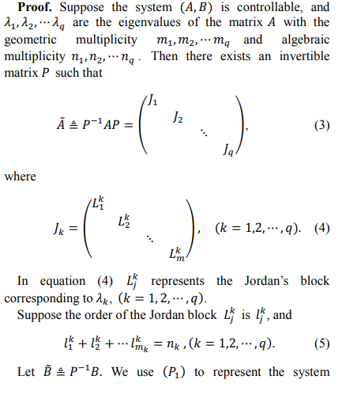
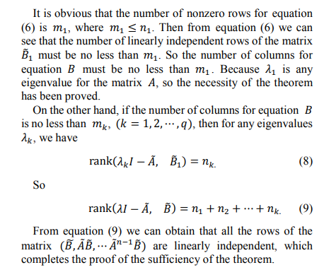

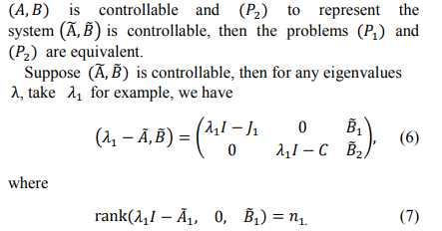
K. J. Somaiya College of Engineering, Mumbai – 400 077
(A Constituent College of Somaiya Vidyavihar University) Dept. of Science and Humanities
F.Y. B. Tech. Semester –I (2022-23)
Applied Mathematics-I
IA-I
NAME : KASHISH MAMANIA
ROLL NO. : 16010122104
DIV: C2 BATCH: 1
Theorem :The linear differential system (A, B) is controllable if and only if the number of columns of the matrix B is no less than the maximum geometric multiplicity of eigenvalues for the matrix A.
References
https://uwaterloo.ca/applied-mathematics/future-undergraduates/what-you-can-learn-applied-mathematics/control-theory#:~:text=Control%20theory%20is%20a%20branch,made%20systems%20and%20biological%20systems.
https://article.sciencepublishinggroup.com/html/10.11648.j.acm.20160503.21.html

